Slide 1

Association of Acrylamide hemoglobin biomarkers with obesity, abdominal obesity and overweight in general US population: NHANES 2003-2006
Miao Cai; Ucheoma Nwaozuru; Steve Scroggins; Thembekile Shato
BST-5210 Categorical Data Analysis
12/13/2018

Slide 2
OUTLINE
1
Introduction
2
Methods
3
Results
4
Discussion & Critique
Notes:
For this presentation I will give a brief overview of health and well-being of young people in Nigeria, our current study and discuss implications of our findings.

Slide 3
1
INTRODUCTION

Slide 4
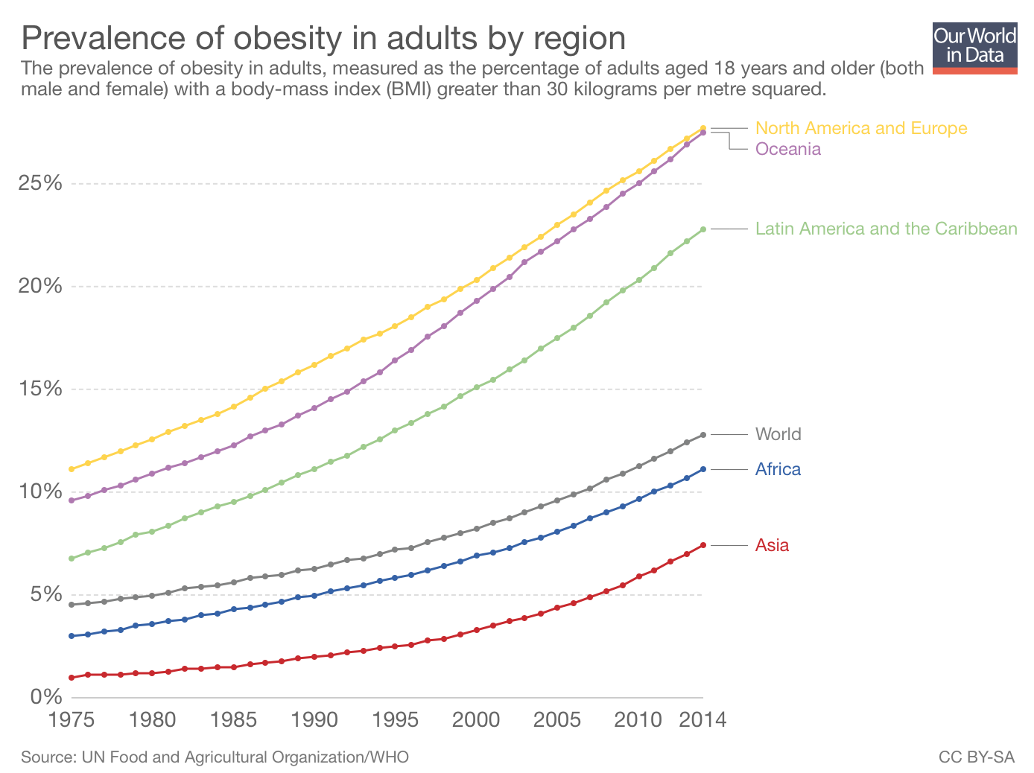
Introduction
Obesity (global pandemic), associated with increased risk of morbidity and mortality
Common causes (excess caloric consumption and sedentary lifestyle), cannot explain obesity epidemic
There is need to explore other “unconventional risk factors”
Notes:
Global pandemic → affects over 1/3 of worldwide population
Map → Increasing prevalence obesity in the past three decades
Uncoventional risk factors → environmental contaminants

Slide 5
Introduction
Sources of Acrylamide (AA):
Food consumption
Skin contact
Occupational inhalation
Tobacco smoking
Previous epidemiological research (general population):
Hypothesis: Long-term exposure to AA is associated with obesity-related outcomes (including abdominal obesity and overweight)
Endocrine disturbances
Acrylamide exposure
Obesity
Insulin resistance
Notes:
Previous studies show correlation between AA and cancer in general population.
AA and endocrine-related cancers (although conclusions are inconsistent and ambiguous)
AA exposure associated with reduced levels of blood insulin and insulin resistance.

Slide 6
2
METHODS

Slide 7
Study Design
The National Health and Nutrition Survey (NHANES) (2003-2006)
Administered by National Center for Health Statistics (NCHS)
“Continuously monitor the nutrition and health status of general US population.”
Cross sectional, every 2 years.
Multistage cluster and stratified probability, nationally representative.
Study Inclusion Criteria
Individuals aged 20-85 years who participated in NHANES.
Individuals with no missing data related to body mass index (BMI), waist circumference, or hemoglobin adduct levels of AA (HbAA & HbGA)
N=8,364
Notes:
Data from this survey comes from the National Health and Nutrition Survey or NHANES.
NHANES is administered by NCHS under the Centers for Disease Control and Prevention.
It’s overall purpose is to monitor nutrition and health status of the general US population.
The survey is collected using multistage clustering and stratified probability to make is nationally representative.
It’s a cross sectional survey given every 2 years.
Data for this study comes from the 2003 and 2005 cycles.
Specific inclusion for this study includes individuals between 20 and 85 years old who had no missing data related to the primary outcome or explanatory variables.
Leaving the final total included at 8.364 participants.

Slide 8

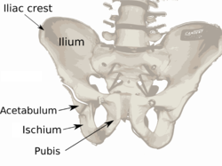
Dependent Variables
General and Abdominal Obesity
General obesity
body mass index (BMI) (fig 1)
3 categorical outcomes
25.0< BMI <30 = overweight
BMI > 30 = obese
Abdominal obesity
Waist circumference (WC)
Measured to the nearest 0.1 cm at the high point of the right iliac crest (fig 2) (at minimal respiration)
Two categorical outcomes
WC >102 cm in men or WC > 88 cm in women = abdominal obesity
Figure 1. Formula to calculate body mass index (in metric)
Figure 2. Skeletal position of the iliac crest, used to measure waist circumference.
Notes:
This study had 3 different dependent variables that were generated from two different survey tools. All of the dependent variables all focus on classifications of obesity.
2 of the dependent variables both come from BMI measurement.
BMI is a calculated health measurement meant to classify individuals into weight classes.
This study was interested in 2 of those classes.
Individuals who had a BMI of above or equal to 25 or below 30 are classified as overweight
Individuals who had a BMI at above 30 are classified at obese.
The third dependent variable abdominal obesity was calculated using waist circumference.
Men with a WC greater than 102, or women with a WC greater the 88 are classified as experiencing abdominal obesity.

Slide 9
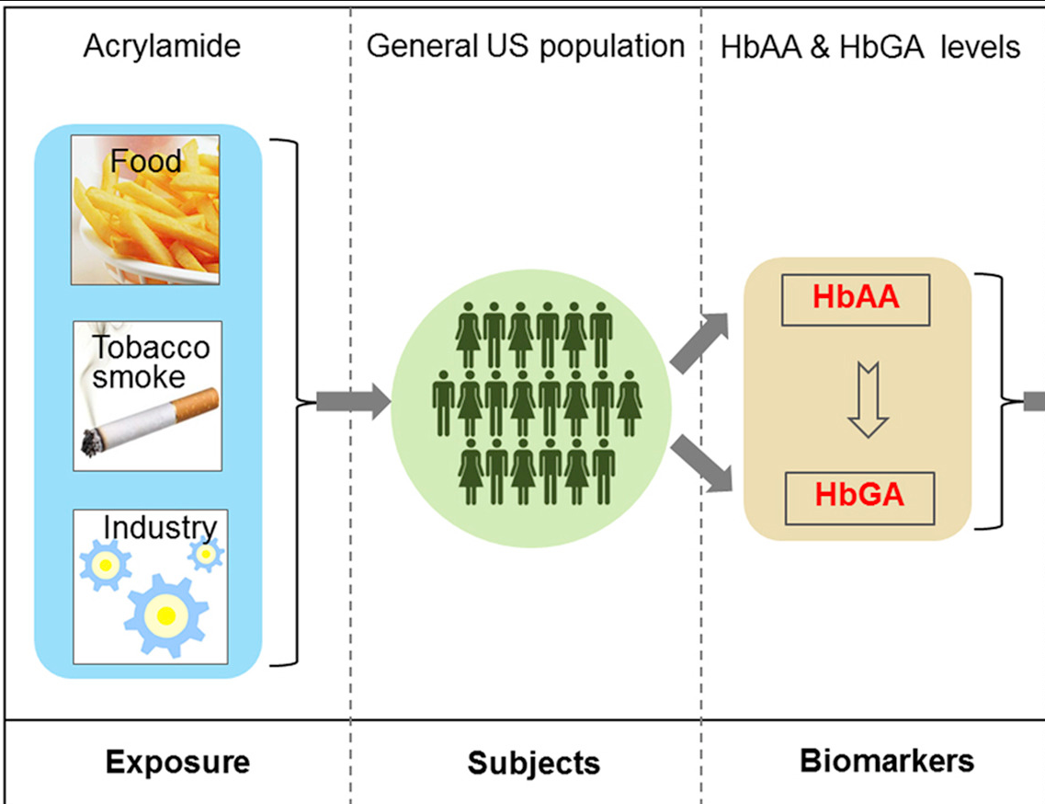
Independent Variables
Hemoglobin Adduct Levels & Sample Demographics
Hemoglobin Adduct Levels
HbAA and HbGA (fig. 3)
Spot blood samples
Adducts extracted and examined using high-performance liquid chromatography tandem mass spectrometry.
Limits of detection within 3 and 4 pmol/g
Each sample measured in duplicate to minimize error
Sociodemographic factors and characteristics
Age, gender, race/ethnicity
Life factors (e.g. marital status, education, income, etc.)
Health factors (e.g. energy in-take, smoking status, etc.)
Figure 3. Detecting acrylamide from HbAA & HbGA
Notes:
The primary explanatory variable for this study was hemoglobin adduct levels. HbAA and HbGA.
Values for these variables were collected from spot blood samples using chemical assays and mass spec techniques.
Each sample was measured 2 to minimize error.
Sociodemographics were also used as independent variables, rather as covariates
Sociodemographics were classified into 1 of 3 groups.
The primary demographics of age, gender, and race/ethnicity. Then life factors such as education and income, then finally health factors like smoking status, etc.

Slide 10
Statistical Analysis
Odds Ratio comparisons
Main predictor construct
HbAA
Abdominal Obesity vs. No Abdominal Obesity
HbGA
PROC SURVEY LOGISTIC REGRESSION
Obesity vs. No Obesity
HbAA + HbGA
Overweight Status vs No Overweight Status
HbAA / HbGA
Sociodemographic Characteristics and Factors
Notes:
Multiple different models were used to determine association between adducts and obesity. First with 4 different means of combining independent variables.
HbAA by itself, then with HbGA by itself, then with the sum measurement of HbAA and HbGA, then finally with the ratio of HbAA to HbGA.
The output of these models were calculated as odds ratios of three different outcomes that we specified,
The likelihood of abdominal obesity vs no obesity, the likelihood of obesity vs no obesity, and the likelihood of being overweight vs not overweight.

Slide 11

Logistic Regression Assumptions
Outcome is binary - obese or not, overweight or not, abdominal obesity or not
Independent observations – cross sectional with no repeated measures
Little or no multicollinearity between independent variables – forward step model construction and assessing effect size.
Linearity in the logit with continuous variables – see above
Large sample size – N>50 + (8 X the number of independent variables) N>8,000
Notes:
Since these are binomial outcomes – binary logistic logit models were used. To employ logistic regression several assumptions have to be met. Firs the outcome must binary. Our outcome here was binary, obese or not, overweight or not. Second we have to have independent observations. Since the NHANES is cross sectional, every observation is an independent person. Next, we need independence or no correlation between independent variables. Since covariates were added as steps, the authors mention observing for this. Next, linearity between the continuous predictor and the logit of the outcome. This can be checked with a scatter plot and it’s assumed the authors did this, but it isn’t explicitly mentioned. Finally a large sample size is needed, since we have over 8,000 and only a few predictors were ok.

Slide 12
Statistical Analysis – Model Construction
Model 1
Crude + demographics
Model 2
Crude + demographics + life factors
Model 3
Crude + demographics + life factors + health factors
Model 4
Crude + demographics + life factors + health factors + additional biomarkers (cotinine)
Missing covariate values substituted with sample medians.
Significance of model interactions assessed with likelihood-ratio tests
Additional analysis removed outliers of main predictors (>99% or <1%)
Significance all two-tailed and reported at alpha=0.05
Confounders identified by >10% change in beta for main effects.
Notes:
Finally we have our model constructions. Each with a crude and then addition of covariates in steps.
Missing independent variables values were replaced with sample medians.
Additional models were also employed that removed outlier values to compare to full models.
All significance is reported at 0.05 alpha levels
And confounders were identified by a 10% increase in main effects.

Slide 13
3
RESULTS

Slide 14
Characteristics of the study population
N = 8364
Aged between 20 and 85 years from NHANES 2003 – 2006
Male: 48.2% and Female:51.8%
Non-Hispanic white: 51.8% , non-Hispanic black: 20.4%, Mexican: 20.7%, Other races: 7.1%
33.99% → obesity
56.11% → abdominal obesity
52.87% → overweight

Slide 15

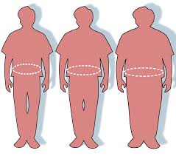
AA hemoglobin biomarkers and obesity
HbAA (pmol/g Hb) ↑ → probability of obesity ↑
HbGA/ HbAA ↓ → probability of obesity↑
HbGA
HbAA + HbGA (pmol/g Hb)
Significant across 4 models: P-values < 0.001
Not consistent significance,
P-values varies across 4 models

Slide 16
Subgroup and sensitivity analysis
Age (<40 or >= 40 years)
Gender
Race/Ethnicity
Education levels
Marriage
Family PIR
Energy intake
Physical activity
Smoking status
Alcohol
History of hypertension
HbGA/HbAA & obesity: consistent in all subgroup analyses
Except for non-Hispanic black and Mexican American subgroups

Slide 17
4
DISCUSSION & CRITIQUE

Slide 18
Main Findings and Study Implications
HbGA, HbGA/HbAA were positively associated with obesity, abdominal obesity, and overweight while controlling for select confounders
HbAA was inversely associated with obesity-related outcomes after adjusting for select confounders
Study findings have implications for public health
The study findings can be generalizable given the nationally representative data source, and the wide age range (20-85 years)
Notes:
Select confounders--- socioeconomic, lifestyle and health-related variables

Slide 19

Strengths
Use of rigorous statistical analysis
(4 statistical models, sensitivity & sub-group analysis)
Uses a nationally representative data
- Relatively large sample size
Detailed overview of the existing body of knowledge
Combines BMI and WC

Slide 20

Limitations
Authors did not clearly delineate what obesity related outcomes (problem in measurement- overlap in measurement)
25.0< BMI <30 = overweight
BMI > 30 = obese
Given the cross-sectional nature of the data, the we cannot truly determine the long-time effect of acrylamide
Some residual confounders were not accounted for
(e.g occupation)
HbGA & HbAA (multicollinearity)
25.0< BMI <30 = overweight
Notes:
Cannnot ascertain the basline exposure to acrylamide

Slide 21
Conclusion
The study found an association between internal exposure to AA with obesity, abdominal obesity and overweight among study participants
The authors recommend that future prospective studies should examine the association between AA exposures and obesity to further confirm the study findings

Slide 22



